Slide 1

Group members
ZU Help App
Simon Zerisenay………………………M80007963
Natnael zerai…………………………..M80007968

Slide 2

Motivation
We saw students and other staffs struggle to find different places inside Zayed university.
We saw students and other staffs struggling to find a medium to report their issues to the responsible authorities inside the university.
We saw students and other staffs struggling to find a medium in which they can share their issues and get instant solution from other students.
We saw students and other staffs struggling to understand the information provided in English language.

Slide 3

Goal of our project
Our goal is to provides solution to all the struggle seen in students and staffs that we have already listed in the above slide in an efficient, easy and satisfying manner.

Slide 4

App structure and Interface
Overall design of the Application components
Student Guide
Database
Mobile Phone
Service
User
External
Database
Service
Server Code
API key

Slide 5
Database
Report Page
Mobile Phone
Service
User
Server
Service
API key
Server Code
Receiver

Slide 6
Ask a Question
Question
Database
User
Mobile Phone
Service
Service
Give Answer
User
Mobile Phone
Question & Answer
Database
Service
View Answer
User
Mobile Phone
Service

Slide 7
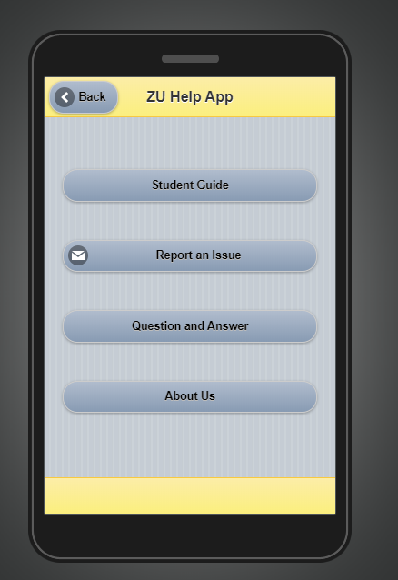
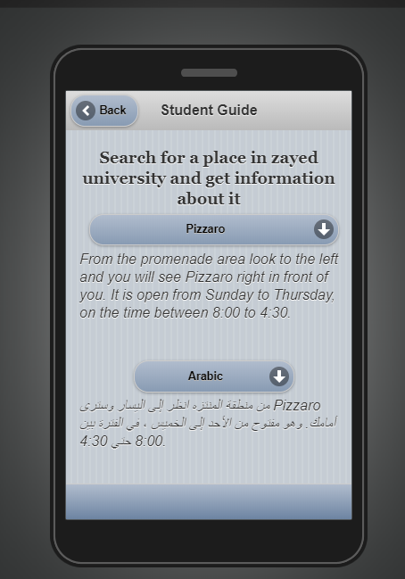
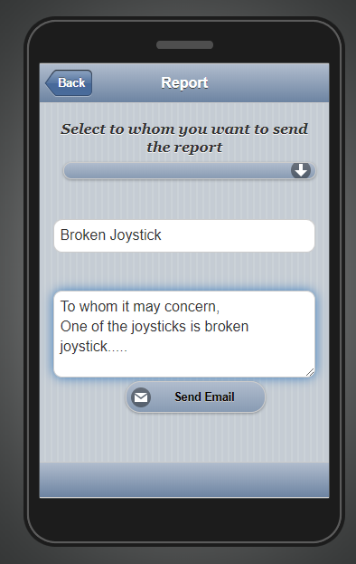
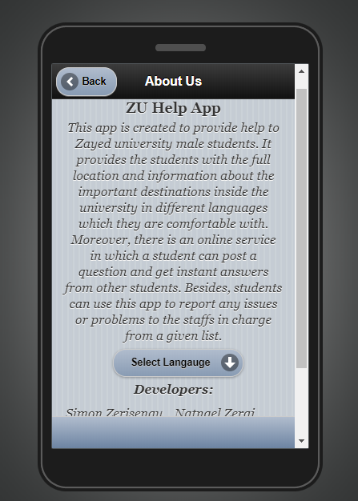
Interfaces of Application with working

Slide 8
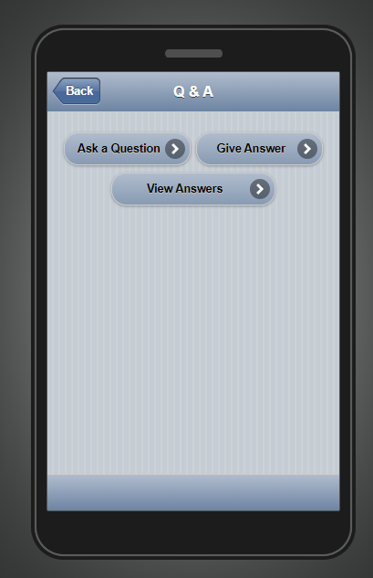
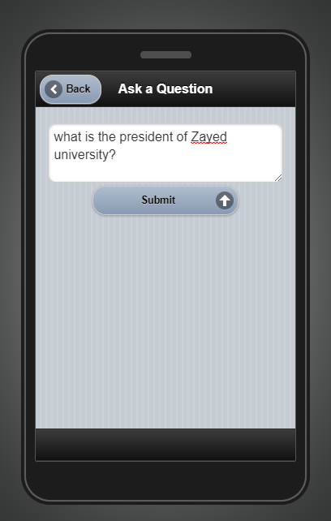
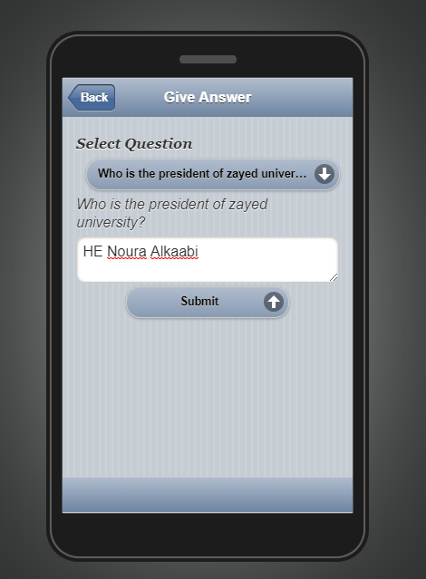
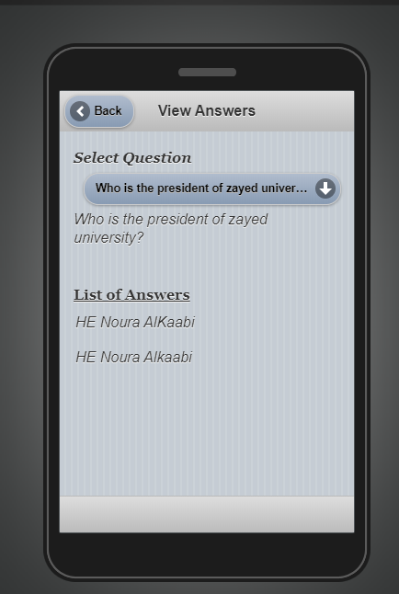
Interface of Application with working

Slide 9
Use of Our Project
Providing:
an easy service in which the students can get information of different destinations inside Zayed university.
an easy medium in which the students can report their issues to the responsible authorities inside the university.
a platform in which the students can share the issues they face with other students.
provide information and instructions in different languages.

Slide 10

Conclusion
In conclusion the application is designed to provide support and help to all students and staffs enrolled in the university and promote them to have a better experience.

